Slide 1



Facebook’s outage likely cost the company over $60 million by Ax Sharma -Ars Technica Blog, 10/5/2021, LINK
By Ryan J. Skelly, IT609 Current Event #1

Slide 2


Who, What, When, Where, and Why??
Facebook, WhatsApp, Instagram
Facebook Data Centers, Routers, DNS Servers
10/4/21, 1pm- 7pm EST
Globally
Faulty Configuration Changes

Slide 3
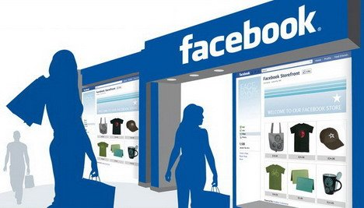
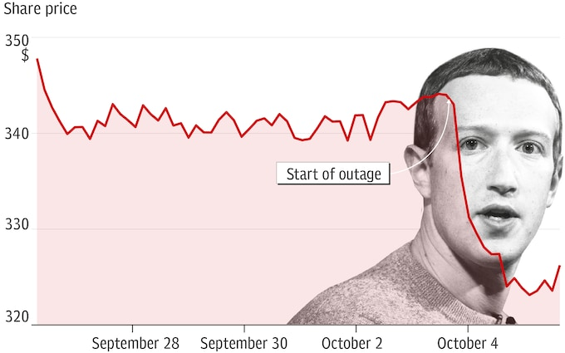
Implications
E-Commerce
Advertising
Consumer Frustration
Stock Shares

Slide 4
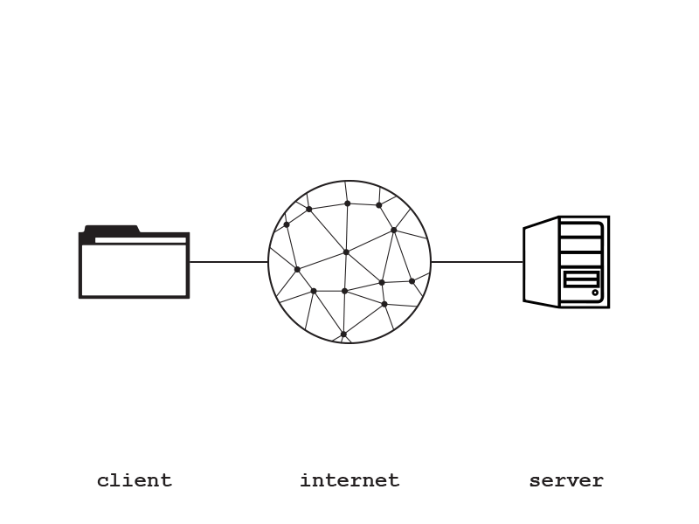
Applications to Class Teachings
Reliability
Network Infrastructure
Updating Live Systems

Slide 5
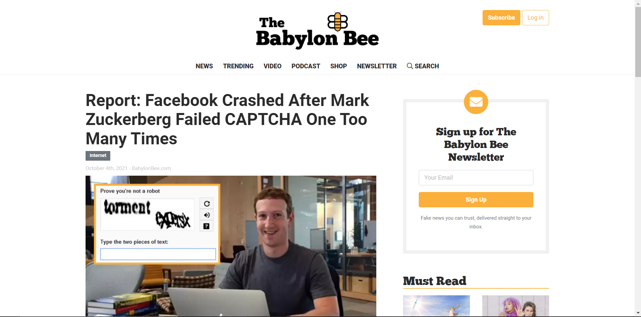
Thanks for Watching!!! 🙂
Any Questions?

